Slide 1


DARAZ headphone data analysis of Bangladesh

Slide 2
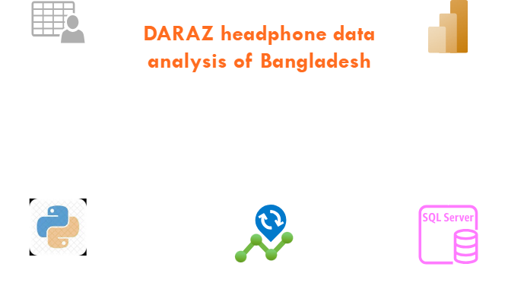

Slide 3
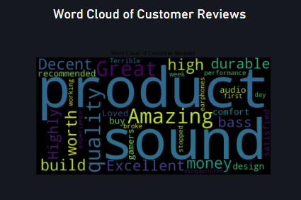
Word cloud analysis is a popular tool for visualizing text data due to its simplicity and effectiveness. A word cloud, also known as a text or tag cloud, is a visual representation of text data where the size of each word indicates its frequency or importance within a given text. Word cloud analysis is often used for visualizing the most prominent terms in textual data like documents, reviews, articles, or any collection of words.

Slide 4
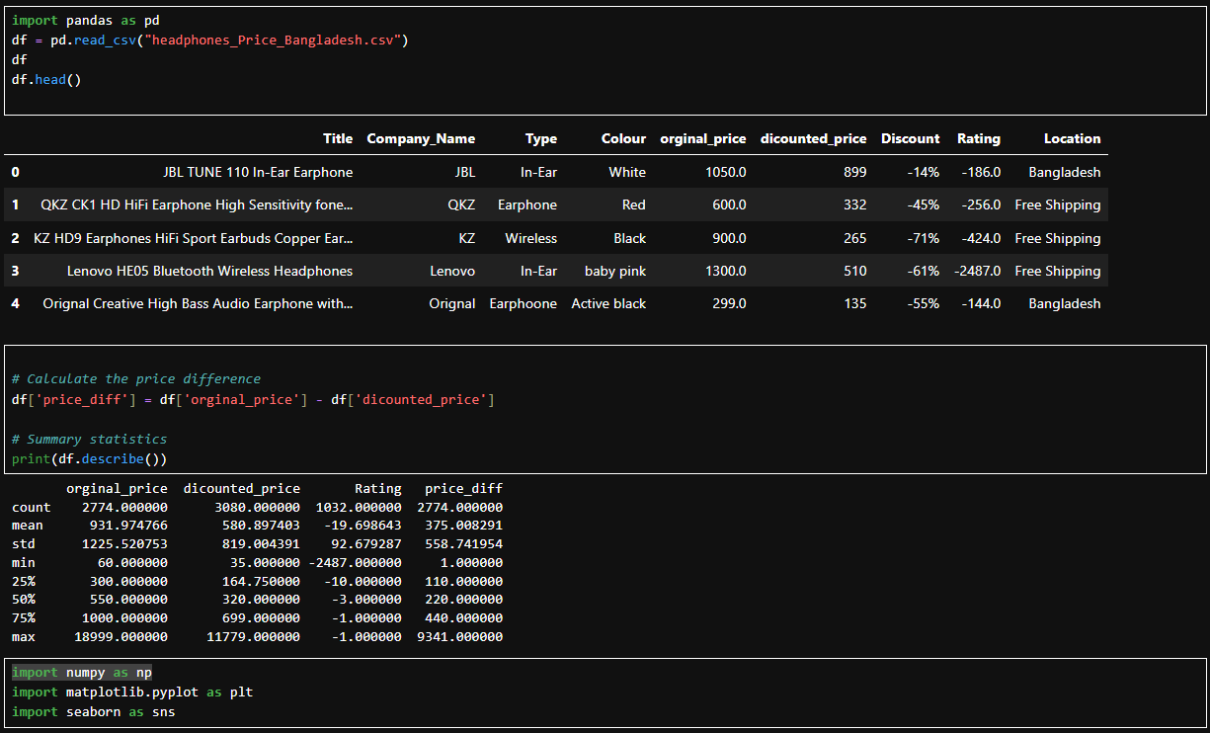
Data Analysis By Python
Different price range segments for headphones in Bangladesh
Brand with most product offerings for the Bd Market
Brand catering to all different segments (low price range, mid price range, high price range)
Most common color and type (on the ear/in the ear etc.) offered by various brands
Compare Two Brands based on details
Are higher rated headphones always high-priced or expensive? and so on…

Slide 5
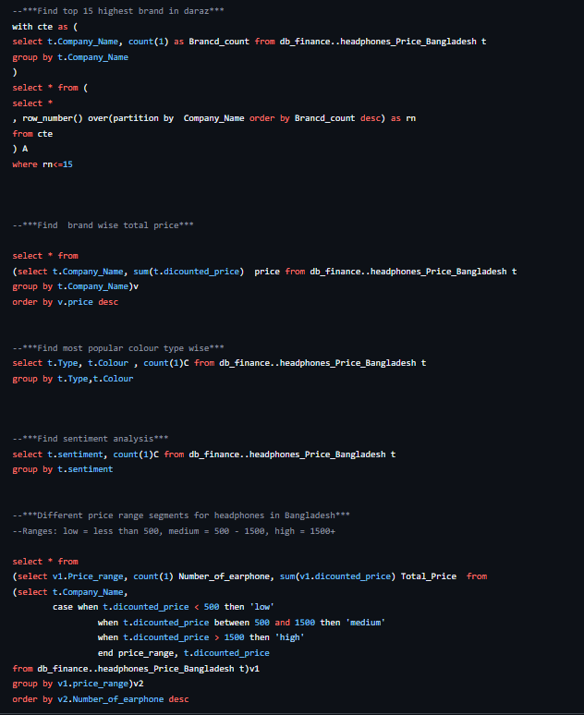
Data Analysis By SQL
Different price range segments for headphones in Bangladesh
Brand with most product offerings for the Bd Market
Brand catering to all different segments (low price range, mid price range, high price range)
Most common color and type (on the ear/in the ear etc.) offered by various brands
Compare Two Brands based on details
Are higher rated headphones always high-priced or expensive? and so on…

Slide 6
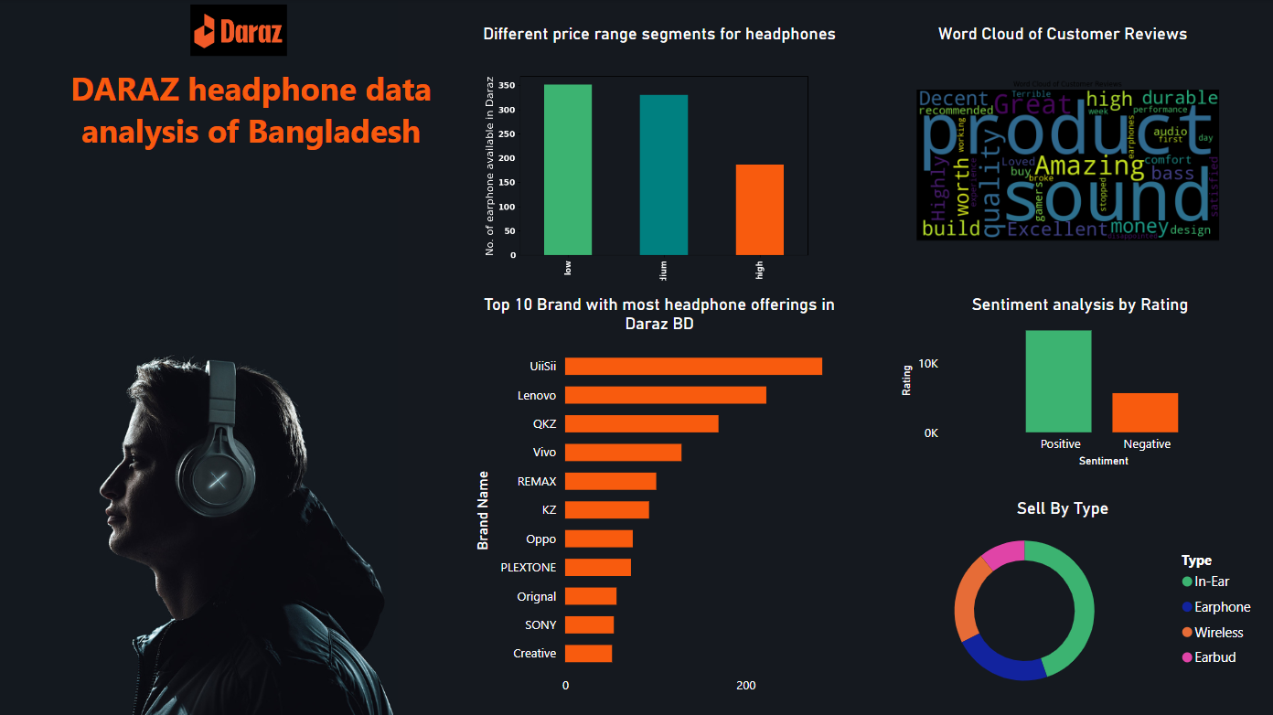

Slide 7
THANK YOU
https://tariqulismail.com/
https://www.linkedin.com/in/tariqulismail/
https://github.com/tariqulismail

